Slide 1
Design of Topics and Partitions

Slide 2
Topic Design
Name
Schema
Payload (Data)
Key
Number of partitions
Number of replicas

Slide 3
The Short Story
DevOps concerns
Bandwidth consumption → Size of messages, `serdes`, etc.
Fault tolerance and availability → Size of cluster, replication factor, etc.
Performance → Partitions, message size, cost of serialization, etc.
Producer concerns
Ease of production → Clear schema, cost of serialization, delivery guarantees, etc.
Consumer concerns
Can I subscribe to only what I need → Topics and partitions
Latency → Cluster size, performance, etc.

Slide 4
How Topics and Partitions Influence Concerns?
Topic topology
Schema (structure, format, etc.)
Temporal constraints (frequency, triggers, etc.)
Do you use topics to allow for fine grain subscriptions?
Partitions
Determines throughput (but not without cost)
Can be used for fine-grained subscription (requires use of low level API)
Recommendation
Use topics to convey semantics
Use partition to control throughput

Slide 5
Name
Descriptive name
Don't hardcode the name all over your application!
Rule of thumb:
Use a longer name that is easy to understand

Slide 6

Schema
JSON
Common choice
Not the most efficient
Apache Avro
Binary format
Compression
Schema evolution
Dynamic typing (no code generation needed for serialization)

Slide 7
Partitions and Throughput
Unit of parallelism: topic partition
Writes to different partitions done in parallel
Consumer: one thread get a single partition's data
Consumer parallelism: bounded by the number of consumed partitions
Throughput on a producer is a function of:
Batching size
Compression codec
Acknowledgement type
Replication factor
Consumer throughput is a function of the message processing logic

Slide 8
Overpartitioning
Problem: Increasing the number of partition and message ordering
If messages have keys, increasing the number of partitions may cause problems
Kafka maps a message to a partition based on the hash of the key
Messages with the same key go to the same partition
If we increase the number of partitions, this does not hold
Messages with the same key may for the retention period appear in multiple partitions
Therefore:
Overpartition for a situation you expect in future

Slide 9
Too Many Partitions
Each partition maps to a directory in the broker
2 files: index, actual data
You may need to configure the open file handle limit
Configuration
Seen in production > 30K open file handles / broker

Slide 10
Partitions and Availability
Intra-cluster replication
A partition can have multiple replicas, each on a different broker
Clean broker shutdown: the controller moves the leaders off the broker that is shutting down
Takes a couple of ms
Unclean shutdown: the loss of availability is dependent on the number of partitions
All replicas become unavailable at the same time
A new leader must be elected
Potential unavailability in seconds

Slide 11
Partitions and End-to-End Latency
Consumers can consume a message after it has been committed
Requires replication to all in-sync replicas
Commit time can be significant
Too long for some real-time systems
A rule of thumb:
Limit the number of partitions per broker to: 100 x (number of brokers) x (replication factor)

Slide 12
Partitions and Client Memory
A producer can set the amount of memory for buffering messages
Messages are buffered per partition
When buffer is full, messages are sent to the broker
More partitions: more message buffering in the producer
If out of memory, producer will block or drop new messages
Reconfigure
Allocate at least a few tens of KB per partition

Slide 13
Summary
Design topics based on your application semantics
Message types
Consumer concerns
Subscription granularity
Decide on the number of partitions based on throughput
The more partitions, the higher theoretical throughput
Not without penalty
File handlers, consumer memory, latency, etc
Evaluate to overpartition to accommodate future growth

Slide 14
Lab: Design
Let's assume you'll have to collect information from devices installed to keep track of the vitals of a set of patients
The patients are being treated from their home
You may assume that the patients produce 10 messages per second on average
You may have up to 1 million patients being tracked at the same time
Multiple stakeholders
Nurse: Keeps track of a number of patients
Service technician: Need to know when a device goes down
Billing: Keeps track of events that are billable
...

Slide 15
Lab: Design... The Question
What would be the topics for such a system?
How do we decide how many partitions per topic?

Slide 16
Lab: Implementation
We'll take a look at a small sleeve of the problem
Service technician's view:
Assuming all devices send a heartbeat
We want to know if the devices go offline and when they come back online
We'll implement a processor that listens to the incoming heartbeats and decides if the device is online or offline

Slide 17
What We'll Run
Device Simulator
Kafka
Processor
device-heartbeat
console-consumer
device-event

Slide 18
Step 1: The Docker Setup
I'm not going to repeat it here, but you'll have to get the docker-compose file to run
Find your IP
ipconfig | grep inet
Edit the docker-compose.yml file to update the IP
docker-compose up

Slide 19
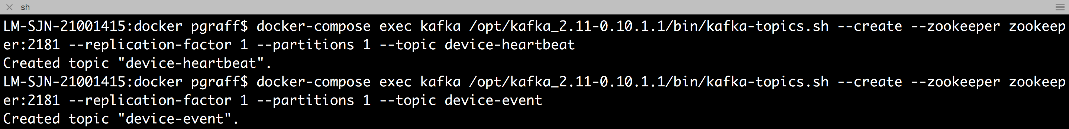
Step 2: Create the Topics
This step we're also been through before. We'll create two topics:
device-heartbeat
device-event
Make sure you're in the docker directory

Slide 20
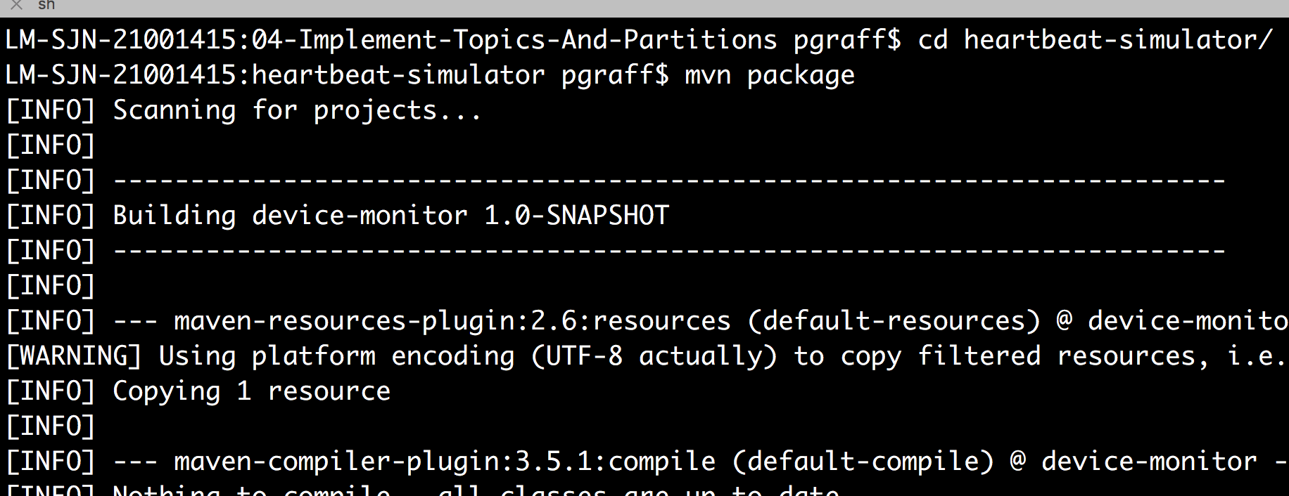
Step 3: Build and run the Device Simulator
Provided is a device simulator
Produces the heartbeat
Randomly will miss the 1 minute deadline to make the processor decide that the device is offline

Slide 21
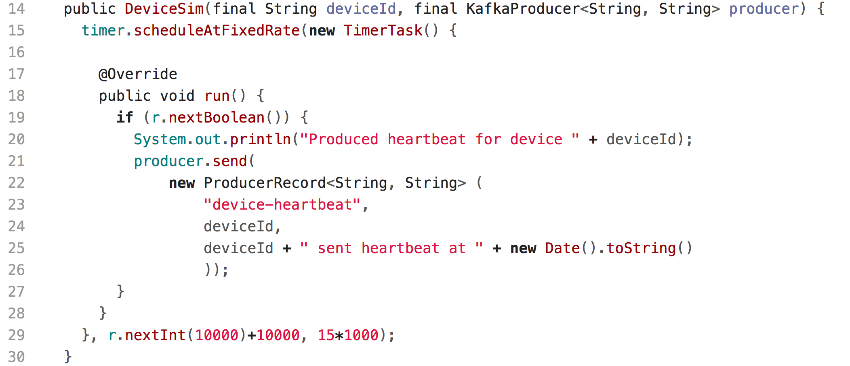
The Critical Code of DeviceSim

Slide 22
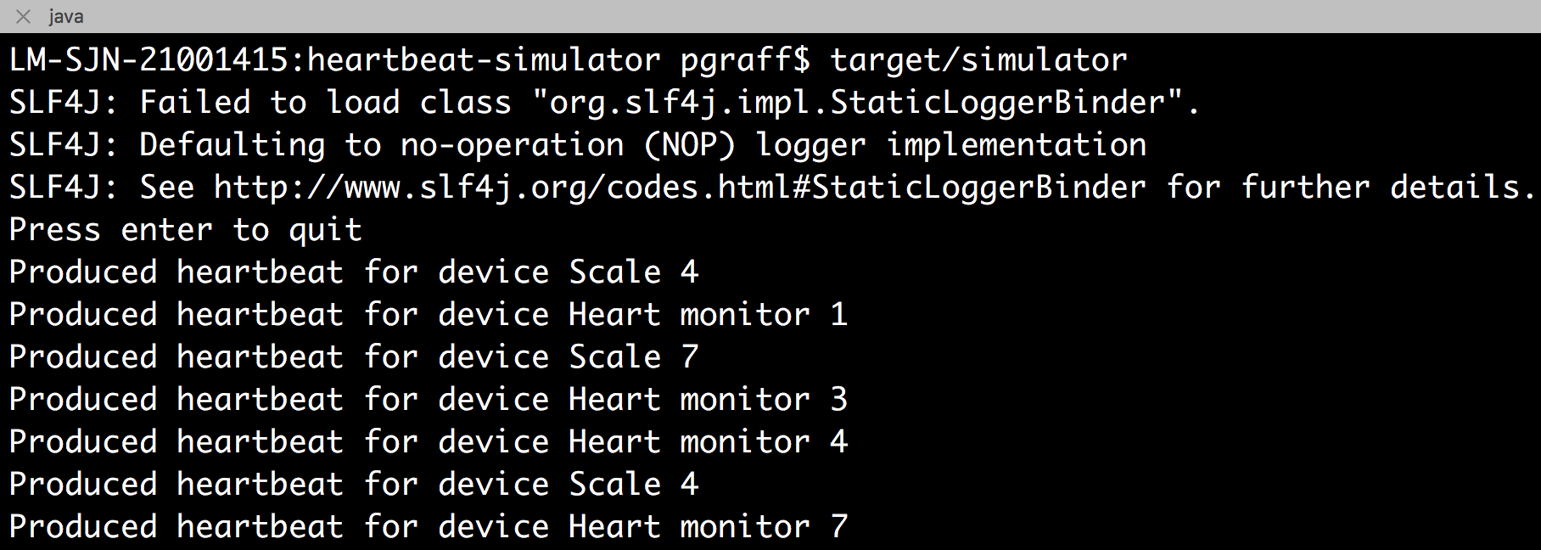
Step 5: Run the DeviceSim
cd kafka-lab/labs/04-Implement-Topics-And-Partitions/device-sim
mvn package
target/simulator

Slide 23
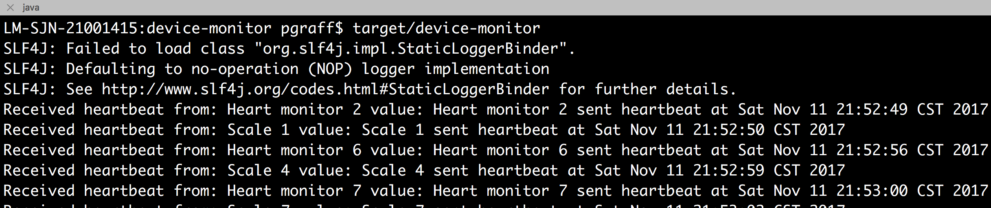
Step 6: Build Device Monitor
cd kafka-lab/labs/04-Implement-Topics-And-Partitions/device-monitor
mvn package
target/device-monitor

Slide 24
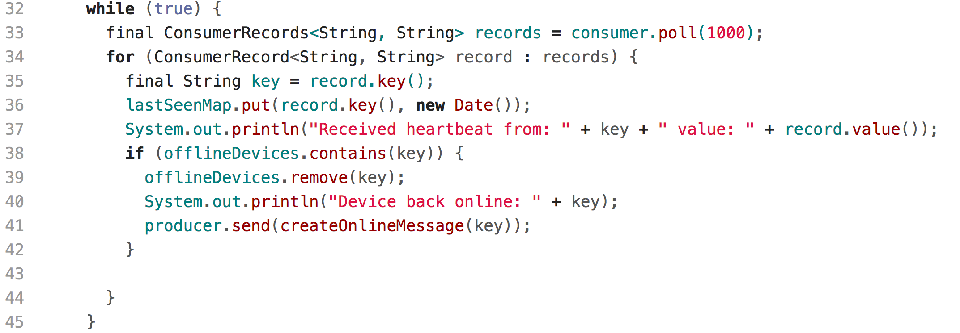
Interesting Code inside the Device Monitor

Slide 25
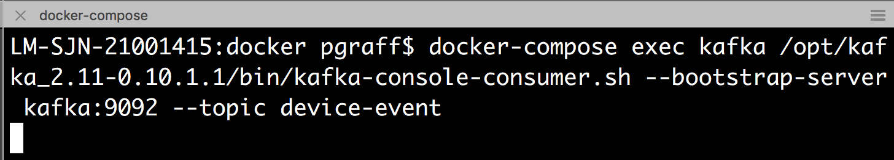
Step 7: Run a Console Consumer
Let's make sure we can see the output from the device monitor
Make sure you're in the docker directory
Run the console-consumer
docker-compose exec kafka /opt/kafka/bin/kafka-console-consumer.sh --bootstrap-server kafka:9092 --topic device-event

Slide 26
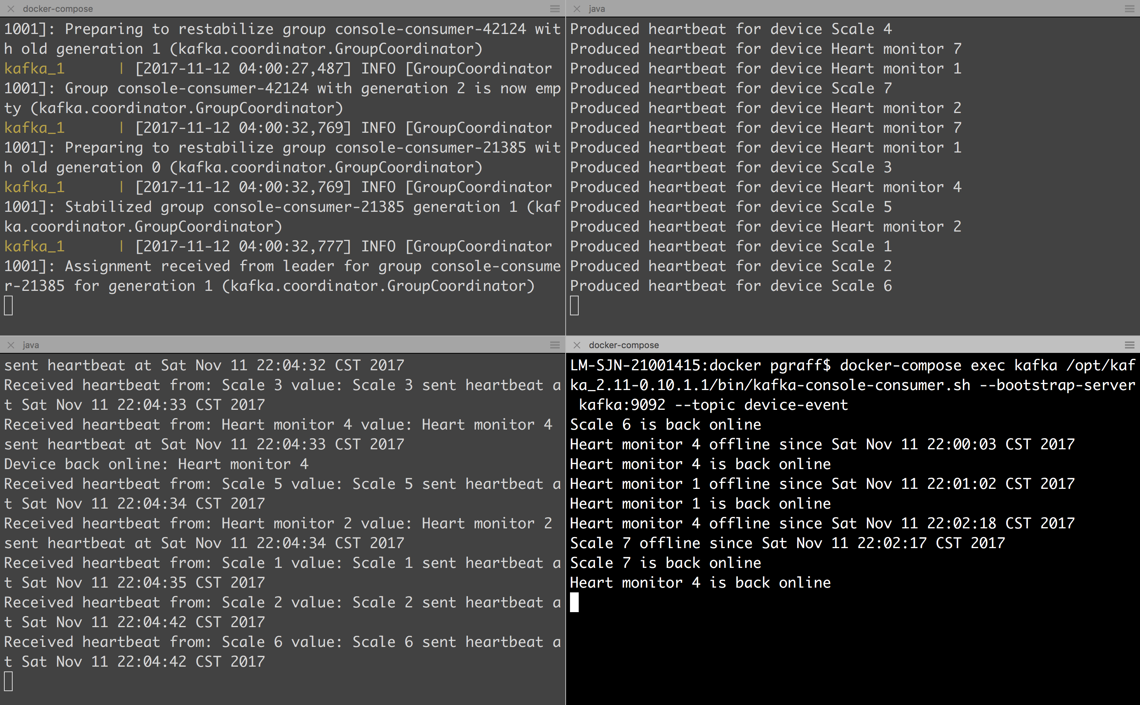
docker-compose Kafka and ZooKeeper
device simulator
device-monitor
console-consumer
www.scispike.com
26

Slide 27
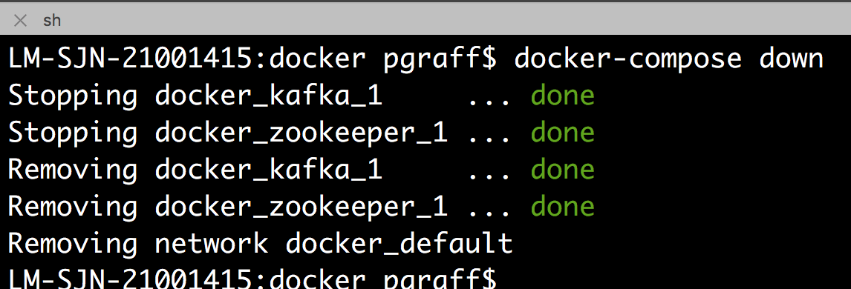
Step 8: Close it all down
docker-compose down

